Slide 1
ME469: Variable Density/Property
Stefan P. Domino^{1,2}
¹ Computational Thermal and Fluid Mechanics, Sandia National Laboratories
² Institute for Computational and Mathematical Engineering, Stanford
SAND2018-4536 PE

Slide 2
What is a Variable-Density/Variable-Property Flow?
Property changes due to energy and species transport, e.g., density, viscosity, mass diffusivity, etc.
Common examples?
Hot/cold jets, fire, plumes, reacting flows (methane and coal combustion), liquids (multi-phase, for another class), etc.
How are equations affected?

Slide 3
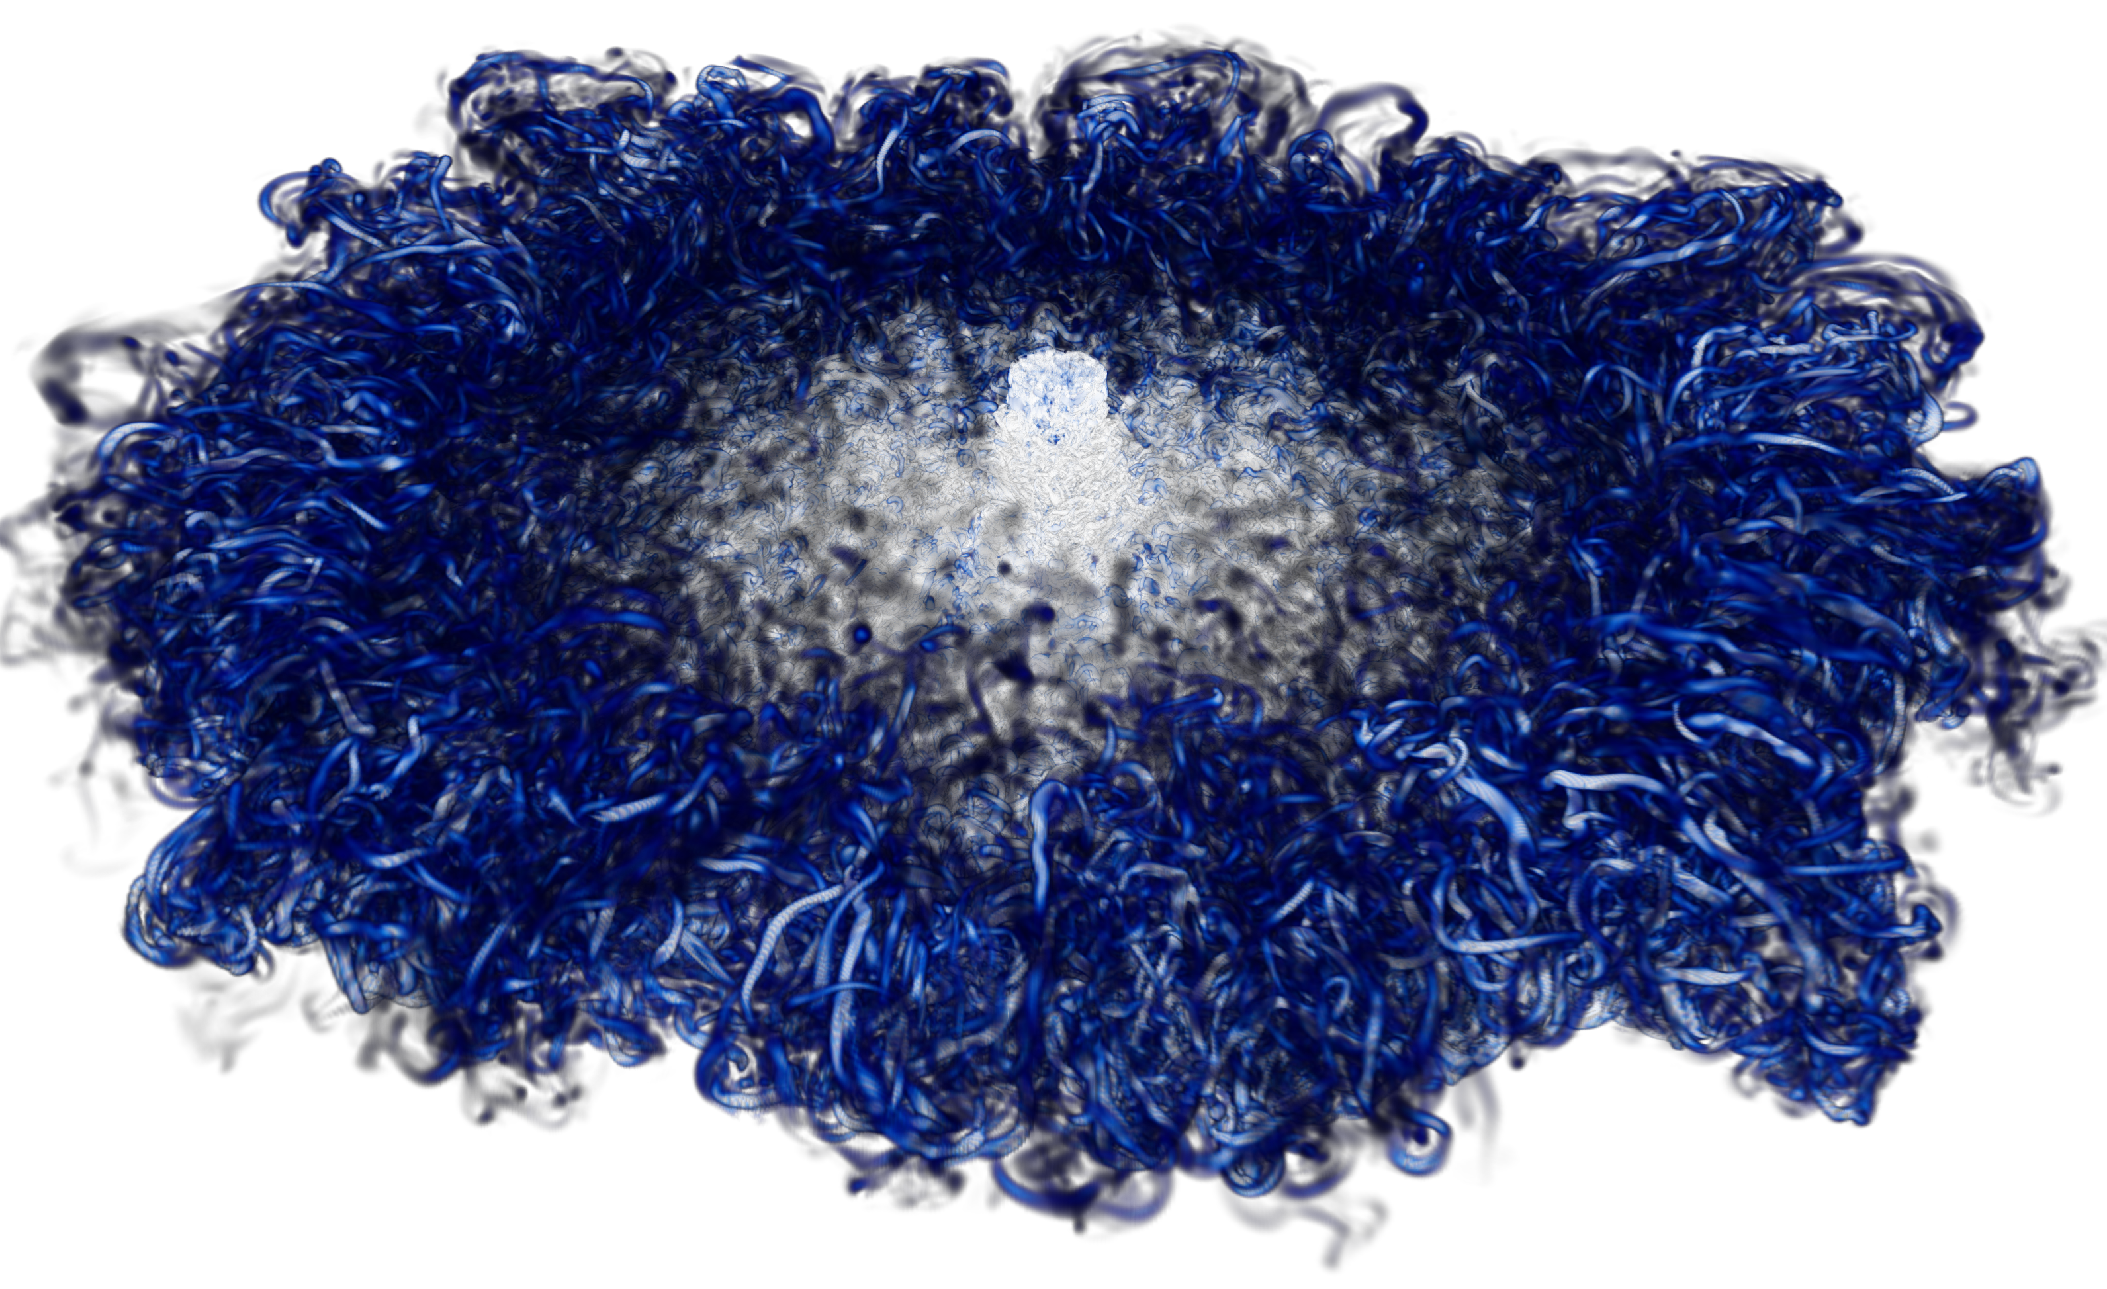
Example: Heated Jet
Property changes due to energy transport, e.g., density and viscosity
How are equations affected?
Ideal gas law
Sutherlands law
Unity Lewis number approximation

Slide 4
Example: Heated Jet, Dive on Unity Lewis Number
Common Assumption: Unity Lewis number, i.e., energy and species diffuse equally (not true for many systems, e.g., Hydrogen gas) where species mass diffusional flux need not be proportional to a species mass fraction gradient
Energy diffusion vector (simplified) is written as:
Where species mass diffusional flux is related to the mass fraction and species mass diffusion velocity:
Yielding:
Useful relationship
(second term: energy due
to mass diffusion)

Slide 5
Example: Heated Jet, Dive on Unity Lewis Number
Common Assumption: Unity Lewis number, i.e., energy and species diffuse equally (not true for many systems, e.g., Hydrogen gas) where species mass diffusional flux need not be proportional to a species mass fraction gradient
Energy diffusion vector (simplified) is written as:
Where species mass diffusional flux is related to the mass fraction and species mass diffusion velocity:
Yielding:
Useful relationship
(second term: energy due
to mass diffusion)
For a Fickian mass diffusion velocity:
When Le = 1, terms cancel

Slide 6
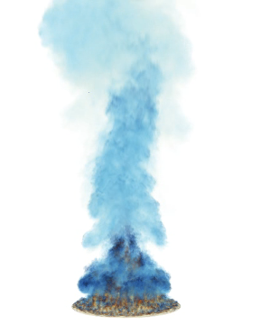
Example: Helium Plume
Property changes due to species transport, e.g., density and viscosity
How are equations affected?
Here, shown to be written in terms of a conserved mixture fraction variable, Z, rather than a set of species mass fractions, Y_{k}
“p” primary
“s” secondary

Slide 7
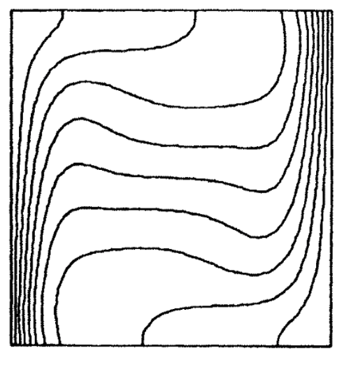
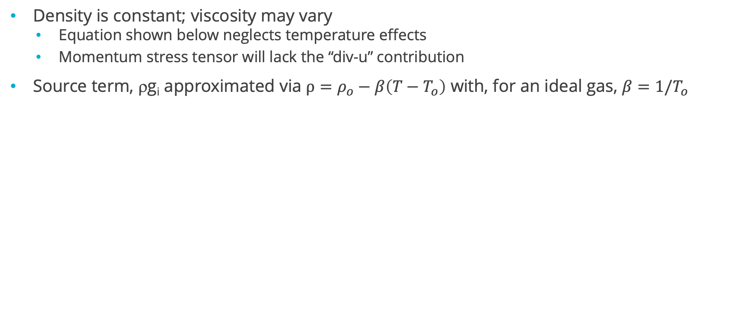
Intermediate Assumption: Boussinesq Approximation
Density is constant; viscosity may vary
Equation shown below neglects temperature effects
Momentum stress tensor will lack the “div-u” contribution
Source term, ρg_{i} approximated via $ρ=ρ_{o}−β\left(T−T_{o}\right)$ with, for an ideal gas, $β=1/T_{o}$
m
De Vahl Davis, “NATURAL CONVECTION OF AIR IN A SQUARE CAVITY A BENCH MARK NUMERICAL SOLUTION”, Int. J. Numer. Method. Fluids (1983)

Slide 8
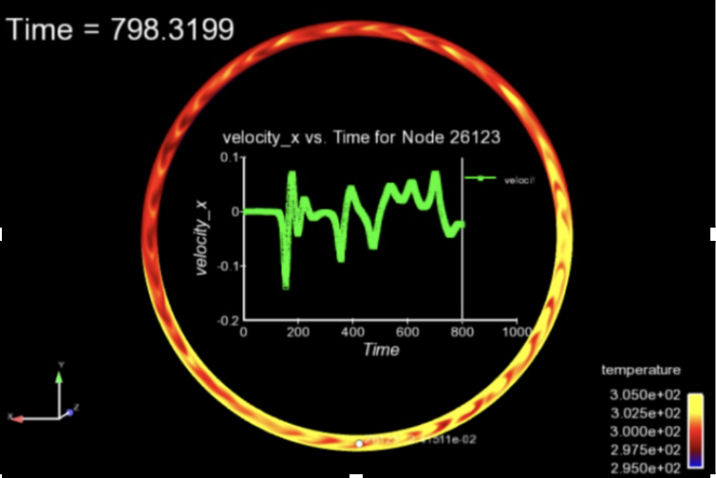
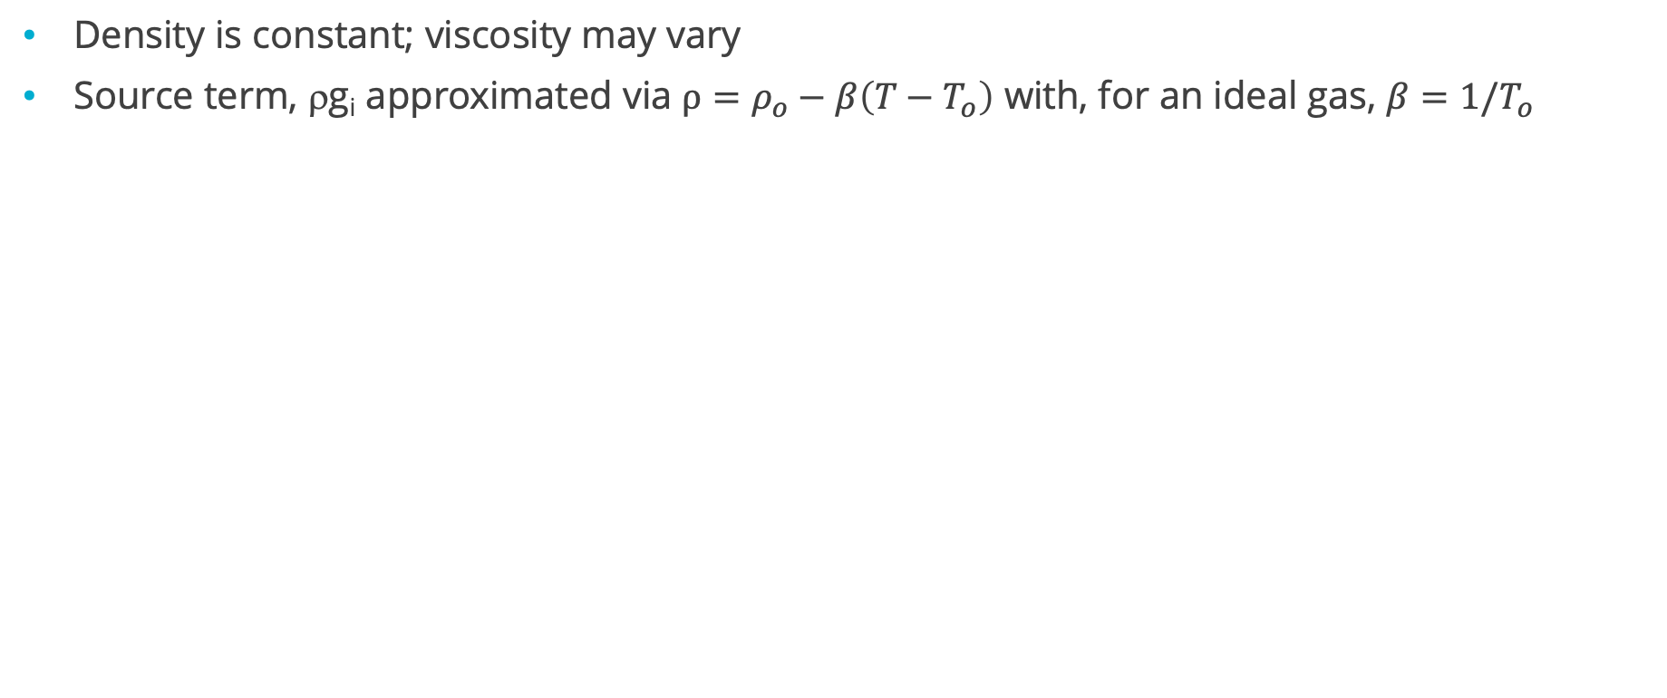
Intermediate Assumption: Boussinesq Approximation
Density is constant; viscosity may vary
Source term, ρg_{i} approximated via $ρ=ρ_{o}−β\left(T−T_{o}\right)$ with, for an ideal gas, $β=1/T_{o}$
m
As with the “hula-hoop” example, water can be used
Good approximation for buoyancy

Slide 9
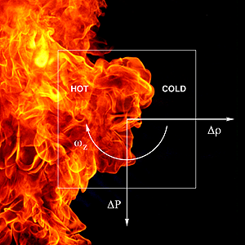
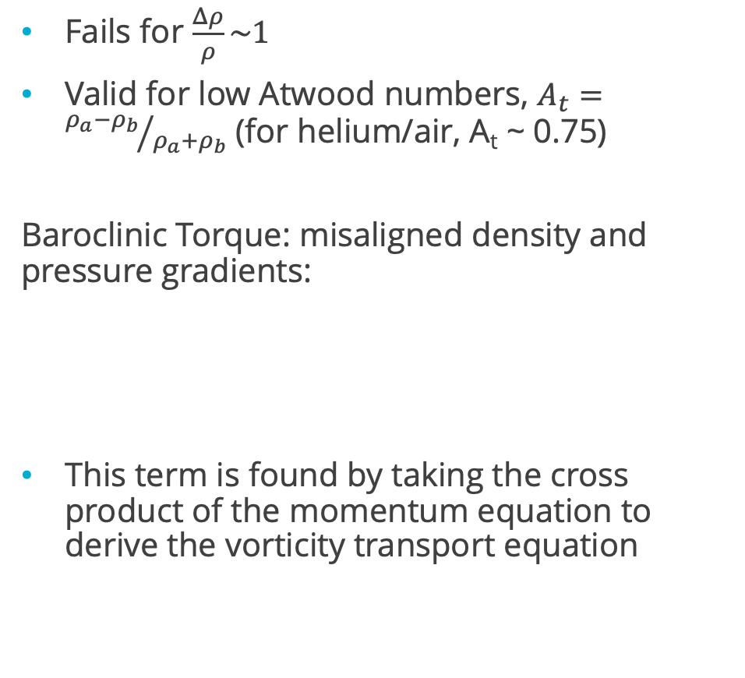
When Does the Boussinesq Approximation Fail? And Why?
Fails for $\frac{Δρ}{ρ}\sim 1$
Valid for low Atwood numbers, $A_{t}={ρ_{a}−ρ_{b}}/{ρ_{a}+ρ_{b}}$ (for helium/air, A_{t} ~ 0.75)
Baroclinic Torque: misaligned density and pressure gradients:
This term is found by taking the cross product of the momentum equation to derive the vorticity transport equation

Slide 10
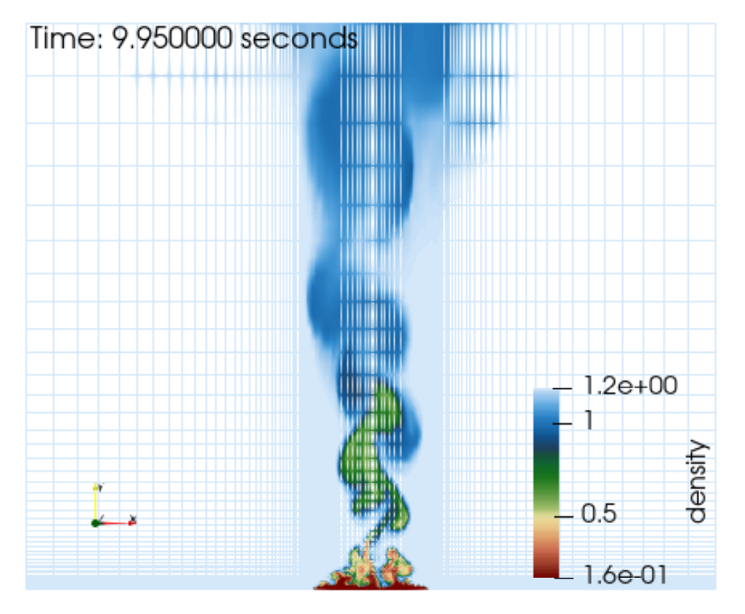
When Does the Boussinesq Approximation Fail?
2D Laboratory
Therefore, the working equations for our helium plume laboratory at near unity Atwood numbers are as follows:
3D DNS
“p” primary
“s” secondary
2D slice of 1 meter helium plume

Slide 11
When Does the Boussinesq Approximation Fail?
2D Laboratory
Therefore, the working equations for our helium plume laboratory at near unity Atwood numbers are as follows:
3D DNS
Note: Buoyancy term can subtract the hydrostatic contribution:
“p” primary
“s” secondary
2D slice of 1 meter helium plume

Slide 12
Ramifications: More Equations to Solve/Couple
Implicit Monolithic (lower left) vs Segregated (lower right)
Explicit, multi-stage RK schemes also are widely used
For a given time step:
do while (!converged) {
}
do while (!converged) {
}
Monolithic, or fully-coupled: One System, One Matrix inversion (Left)
Segregated: Multiple Systems

Slide 13
Pressure Projection For Variable Density
Semi-discrete approach (uniform density) Fully discrete approach
Chorin (1968)
Time scale is the time step:
Fully discrete approach
Factored matrix: is an approximation to
SIMPLE family of methods
Time scale is the characteristic scale of :
For convection-dominated flows, this looks like Δx/U
$$\left[\begin{matrix}A & G \\ D & 0\end{matrix}\right]\left[\begin{matrix}u^{n+1} \\ p^{n+1}\end{matrix}\right]=\left[\begin{matrix}f \\ 0\end{matrix}\right]+\left[\begin{matrix}\left(I−Aτ\right)G{(p}^{n+1}−p^{n}) \\ {τ\left(L−DG\right)(p}^{n+1}−p^{n})\end{matrix}\right]$$

Slide 14
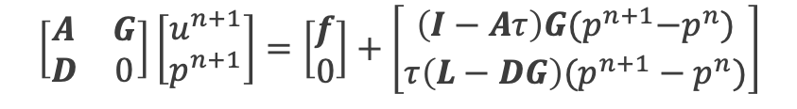
Pressure Projection For Variable Density
Semi-discrete approach (variable density) Fully discrete approach
Fully discrete approach
Factored matrix: is an approximation to
SIMPLE family of methods
Time scale is the characteristic scale of :
For convection-dominated flows, this looks like Δx/U
D operator now
Includes density
scaling
$$\left[\begin{matrix}A & G \\ D & 0\end{matrix}\right]\left[\begin{matrix}u^{n+1} \\ p^{n+1}\end{matrix}\right]=\left[\begin{matrix}f \\ 0\end{matrix}\right]+\left[\begin{matrix}\left(I−Aτ\right)G{(p}^{n+1}−p^{n}) \\ {τ\left(L−DG\right)(p}^{n+1}−p^{n})\end{matrix}\right]$$

Slide 15
Special Ordering
Order can be changed to increase convergence and consistency
“predictor/corrector” approaches are common
{
{
Shunn et al., JCP, 2012
do while (!converged) {
}
do while (!converged) {
}
For a given
time step:
For a given
time step:

Slide 16
Other Ramifications: Properties to Interpolate to Integration Points
Advection and Diffusion Example
Element-based (same applies for the two-state schemes)
Sometimes, a code implementation chooses to express properties, even when constant, as interpolated – solely for generality of implementation

Slide 17
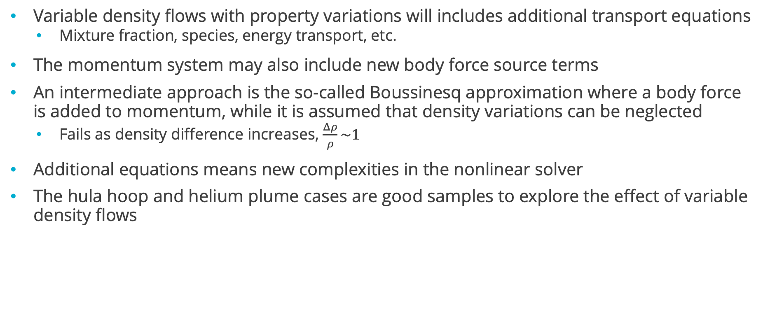
Final Points
Variable density flows with property variations will includes additional transport equations
Mixture fraction, species, energy transport, etc.
The momentum system may also include new body force source terms
An intermediate approach is the so-called Boussinesq approximation where a body force is added to momentum, while it is assumed that density variations can be neglected
Fails as density difference increases, $\frac{Δρ}{ρ}\sim 1$
Additional equations means new complexities in the nonlinear solver
The hula hoop and helium plume cases are good samples to explore the effect of variable density flows

